Slide 1




Slide 2

MAXIMUM EQUILIBRIUM SUM PROBLEM

Slide 3

TEST TIME ON MAXIMUM SUM OF HOURGLASS IN MATRIX
URL:https://forms.gle/prKvyLf9HCepeagW6
QR CODE:

Slide 4
MAXIMUM EQUILIBRIUM SUM PROBLEM
Introduction:
The maximum equilibrium sum problem involves finding the split point in an array where the sum of elements on the left of that split is closest to equaling the sum of elements on the right of that split.

Slide 5
Equilibrium Sum Vs Maximum Equilibrium Sum
An Equilibrium Sum is found at an index i where the sum of array elements from 0 to i-1 equals the sum of elements from i to the end of the array.
The Maximum Equilibrium Sum is found by choosing the split point i where the absolute difference between the left sum and right sum is the smallest.

Slide 6
Finding the Maximum Equilibrium Sum of the array {1, 2, 3, 5, 3,2,1}
Split point at index 0:
Left sum = 1
Right sum = 16 (2 + 3 + 5 + 3 + 2 +1)
Absolute difference = 15
1 | 2 | 3 | 5 | 3 | 2 | 1
Split point at index 1:
Left sum = 3
Right sum = 14 (3 + 5 + 3 + 2 + 1)
0 | 1 | 2 | 3 | 4 | 5 | 6
Absolute difference = 11
Split point at index 2:
Left sum = 6
Right sum = 11 (5 + 3 + 2 +1 )
Absolute difference = 5

Slide 7
Split point at index 3:
Left sum = 11
Right sum = 6 (3 + 2 + 1)
Absolute difference = 5
Split point at index 4:
Left sum = 14 (1 + 2 + 3 + 5)
Right sum = 6 (3 + 2 + 1)
1 | 2 | 3 | 5 | 3 | 2 | 1
Absolute difference = 8
Split point at index 5:
Left sum = 16
0 | 1 | 2 | 3 | 4 | 5 | 6
Right sum = 3 (2 +1)
Absolute difference = 13
Split point at index 6:
Left sum = 17
Right sum = 0
Absolute difference = 17

Slide 8
The split point with the minimum absolute difference between left and right sums is at index 3.
Therefore;
1 | 2 | 3 | 5 | 3 | 2 | 1
Left sum = 11
Right sum = 6
Split point = 5
0 | 1 | 2 | 3 | 4 | 5 | 6

Slide 9
More details of Maximum Equilibrium Sum Problem:
The goal is to find the split point in an array where the sum of elements on the left side is closest to equaling the sum of elements on the right side.
This split point represents the maximum equilibrium sum. It has the minimum absolute difference between the left sum and right sum.
An equilibrium sum is found at an index i where the sum of elements from 0 to i-1 equals the sum of elements from i to the end of the array.

Slide 10
Techniques:
Simple Approach
It involves iterating over all possible split points and calculating the left sum and right sum for each split. This has O(n^2) time complexity.
Precompute both left sums and right sums
This allows for calculating the right sum for each split. This reduces the time complexity to O(n).

Slide 11
Simple Approach
It initializes res to Integer.MIN_VALUE to store the maximum equilibrium sum seen so far.
It iterates from 0 to n-1, where n is the array size. For each index i:
It calculates the prefix sum prefix_sum from index 0 to i.
It calculates the suffix sum suffix_sum from index i+1 to n-1.
It checks if prefix_sum == suffix_sum. If so, it has found an equilibrium point. It updates res to the maximum of res and prefix_sum.
Then, res contains the maximum equilibrium sum in the array.
Finally, It prints the result

Slide 12
import java.util.*; class Main { static int findMaxSum(int []arr, int n) { int res = Integer.MIN_VALUE; for (int i = 0; i < n; i++) { int prefix_sum = arr[i]; for (int j = 0; j < i; j++) prefix_sum += arr[j]; int suffix_sum = arr[i]; for (int j = n - 1; j > i; j--) suffix_sum += arr[j]; if (prefix_sum == suffix_sum) res = Math.max(res, prefix_sum); } return res; } | public static void main(String[] args) { Scanner s = new Scanner(System.in); System.out.println("Enter size of the array"); int n = s.nextInt(); int[] arr = new int[n]; System.out.println("Enter elements of the array"); for (int i = 0; i < n; i++){ arr[i] = s.nextInt(); } System.out.println(findMaxSum(arr, n)); } }

Slide 13
Time and space complexity
Time Complexity: O(n²) Space Complexity: O(1)

Slide 14
Precompute both left sums and right sums
The method first calculates the prefix sum of arr and stores it in the preSum array.
It then calculates the suffix sum of arr and stores it in the suffSum array.
If the suffix sum of the entire array is equal to the prefix sum of the entire array, the method updates the maximum equilibrium sum.
Then iterates over the array from right to left, calculating the suffix sum of each subarray and comparing it with the prefix sum of the same subarray.
If they are equal, the method updates the maximum equilibrium sum.

Slide 15
import java.io.*; public class Main { static int findMaxSum(int []arr, int n) { int []preSum = new int[n]; int []suffSum = new int[n]; int ans = Integer.MIN_VALUE; preSum[0] = arr[0]; for (int i = 1; i < n; i++) preSum[i] = preSum[i - 1] + arr[i]; suffSum[n - 1] = arr[n - 1]; if (preSum[n - 1] == suffSum[n - 1]) ans = Math.max(ans, preSum[n - 1]); for(int i = n - 2; i >= 0; i--) | { suffSum[i] = suffSum[i + 1] + arr[i]; if (suffSum[i] == preSum[i]) ans = Math.max(ans, preSum[i]); } return ans; } static public void main (String[] args) { int []arr = { -2, 5, 3, 3, 2, 6, -4, 2 }; int n = arr.length; System.out.println( findMaxSum(arr, n)); } }

Slide 16
Precompute both left sums and right sums
Time and space complexity
Time Complexity: O(n) Space Complexity: O(1)

Slide 17
Interview Questions
What is the maximum equilibrium sum problem?
The maximum equilibrium sum problem involves finding the split point in an array where the sum of elements on the left of that split is closest to equaling the sum of elements on the right of that split.

Slide 18
Interview Questions
What is the time complexity of your algorithm?
The time complexity is O(n) where n is the length of the array, as we traverse the array only once.

Slide 19
Interview Questions
What is the space complexity of your algorithm?
The space complexity is O(1) as we do not use any additional space.

Slide 20

https://learn.codemithra.com

Slide 21
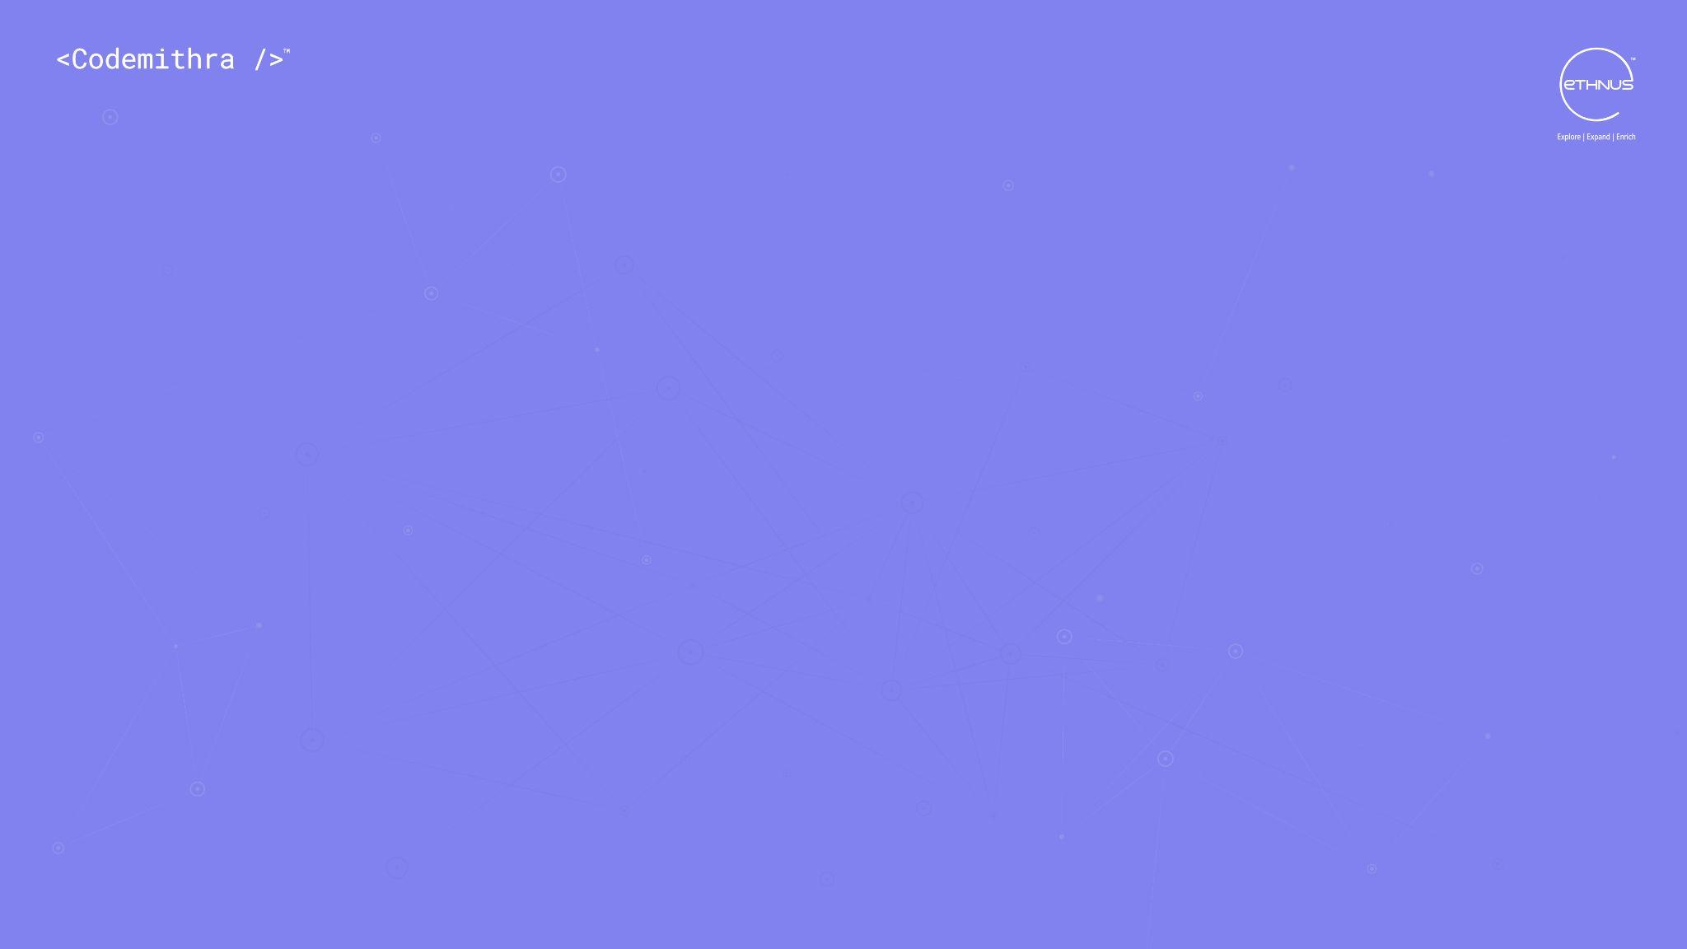



THANK YOU
+91 78150 95095
codemithra@ethnus.com
www.codemithra.com

